Slide 1
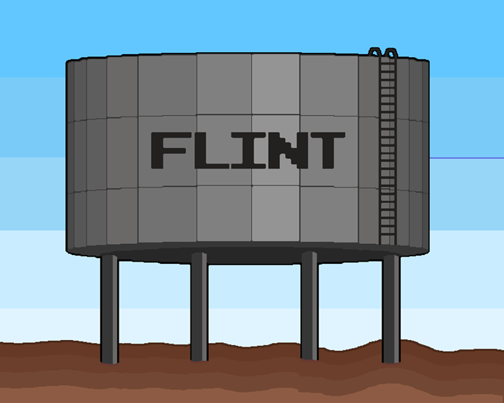
Flint
RJ^3
Ryan Shee : Lead Programmer
Jasper Yeh : Lead Artist / Programmer
Jeffrey Hui : Sound / Level Design / Programmer
Jerry Liu : Programmer / Art

Slide 2
Summary of Flint
Flint is a top-down puzzle game taking place in the underground water pip system of Basin county.
The player must traverse through the levels to fix leaking pipes as well as clean up some of the waste that has accumulated as a result of deteriorating pipes
The player feels tension as he/she has to complete the level before all the clean water goes to waste.

Slide 4
Challenges
Phaser hitbox
Pixel art assets
Storyline
Level Design
Cut boss level

Slide 5
Successes
Player interactions with objects
Good management of the designing process
Tile layer collisions
Sprite animations
We were able to understand and use most of the Phaser Library
We made a game hehe XD

